Slide 1
Agentic RAG Chatbot For Multi-Format Document QA Using MCP Subtitle: Coding Task Submission Name: Munesula Vamshi Date: 29/09/2025

Slide 2
Project analysis slide 2
PROBLEM STATEMENT
Need a chatbot that can answer queries using multiple document formats (PDF, PPTX, CSV, DOCX, TXT/MD).
Must follow an agentic architecture with well-defined roles.
Require Model Context Protocol (MCP) for structured communication between agents.
Ensure retrieval accuracy with embeddings and vector database.
Support multi-turn conversational flow with source-backed responses.

Slide 3
Project analysis slide 2
OBJECTIVES
Build an agent-based RAG chatbot.
Enable multi-format document ingestion & parsing.
Use embeddings + vector DB for semantic retrieval.
Ensure structured communication between agents via MCP.
• Provide a user-friendly chatbot interface.

Slide 4
Project analysis slide 2
PROPOSED SOLUTION
IngestionAgent → Parses & preprocesses uploaded docs.
RetrievalAgent → Handles embeddings + semantic search.
LLMResponseAgent → Combines query + retrieved chunks → calls LLM.
MCP Messaging → Agents communicate with structured context objects.
UI → Streamlit interface for uploads, multi-turn chat, and responses.

Slide 5
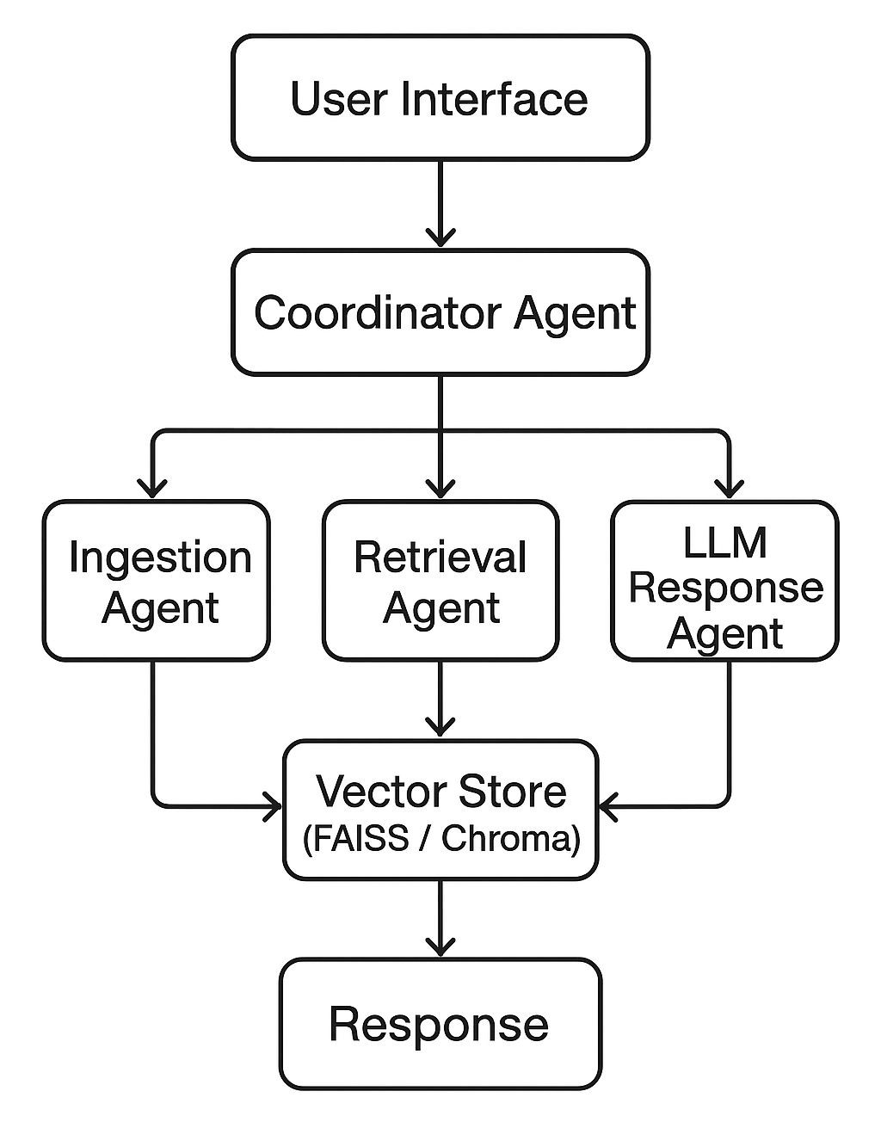
Project analysis slide 2
SYSTEM ARCHITECTURE

Slide 6
Project analysis slide 2
TECH STACK
Programming: PythonUI
Framework: Streamlit
Embeddings: HuggingFace / OpenAI
Vector DB: FAISS / Chroma
Communication: Model Context Protocol (MCP)
LLM: OpenAI GPT / HuggingFace

Slide 7
Project analysis slide 2
KEY FEATURES
Multi-format document support (PDF, PPTX, DOCX, CSV, TXT/MD).
Agentic architecture with 3+ agents.
Structured communication via MCP.
Accurate semantic retrieval using embeddings + vector DB.
Multi-turn chatbot with contextual answers + sources.

Slide 8
Project analysis slide 2
CONCLUSING & FUTURE SCOPE
CONCLUSION:
• Built a functional Agentic RAG Chatbot.
• Integrated MCP messaging for clear agent communication.
• Delivered with GitHub repo, PPT, and video explanation.
FUTURE SCOPE
• Add support for Excel, images, audio.
• Deploy on cloud for scalability.
• Use hybrid retrieval (BM25 + embeddings) for improved accuracy.

Slide 9
Thank You

